Slide 1


Seminar University of Duisburg-Essen
Climate Risk Disclosure and Institutional Investors
Zacharias Sautner (with E. Ilhan, P. Krueger, L. Starks)

Slide 2
Objectives of my talk
Some evidence
Some hope
Some action guidance
Notes:
Emphasize how important it is to have an objective function that is observable and measurable. Note that stock prices provide almost instantaneous feedback (some of which is unwelcome) on every decision you make as a firm.
Consider the example of an acquisition announcement and the market reaction to it. Stock prices of the acquiring firm tend to drop in a significant proportion of acquisitions. Why might markets be more pessimistic than managers about the expected success of an acquisition? Because the track record of firms on acquisitions is not very good.

Slide 3
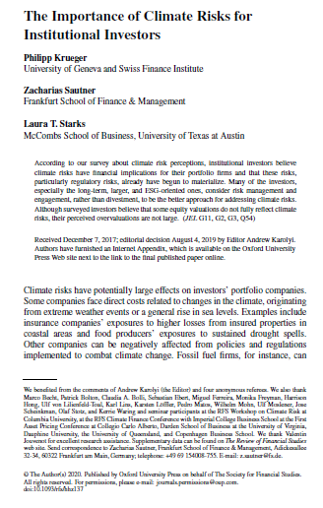
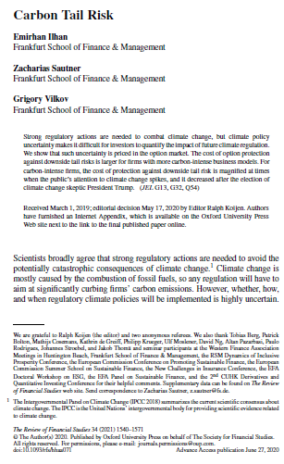
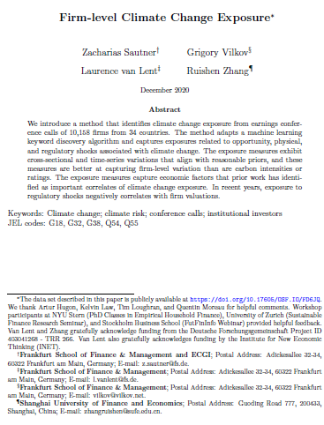
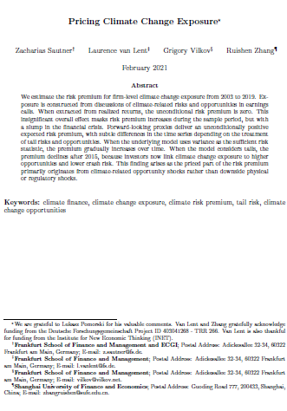
Notes:
Emphasize how important it is to have an objective function that is observable and measurable. Note that stock prices provide almost instantaneous feedback (some of which is unwelcome) on every decision you make as a firm.
Consider the example of an acquisition announcement and the market reaction to it. Stock prices of the acquiring firm tend to drop in a significant proportion of acquisitions. Why might markets be more pessimistic than managers about the expected success of an acquisition? Because the track record of firms on acquisitions is not very good.

Slide 4

Importance of climate-related information
Financial market efficiency relies on timely and accurate information regarding firms’ risk exposures
An increasingly important risk exposure relates to climate change
High-quality information on firms’ climate risk exposures is necessary for informed investment decisions and the correct market pricing of climate-related risks and opportunities
Sound disclosure on climate risks also essential for regulatory efforts to protect financial stability
Notes:
Emphasize how important it is to have an objective function that is observable and measurable. Note that stock prices provide almost instantaneous feedback (some of which is unwelcome) on every decision you make as a firm.
Consider the example of an acquisition announcement and the market reaction to it. Stock prices of the acquiring firm tend to drop in a significant proportion of acquisitions. Why might markets be more pessimistic than managers about the expected success of an acquisition? Because the track record of firms on acquisitions is not very good.

Slide 5
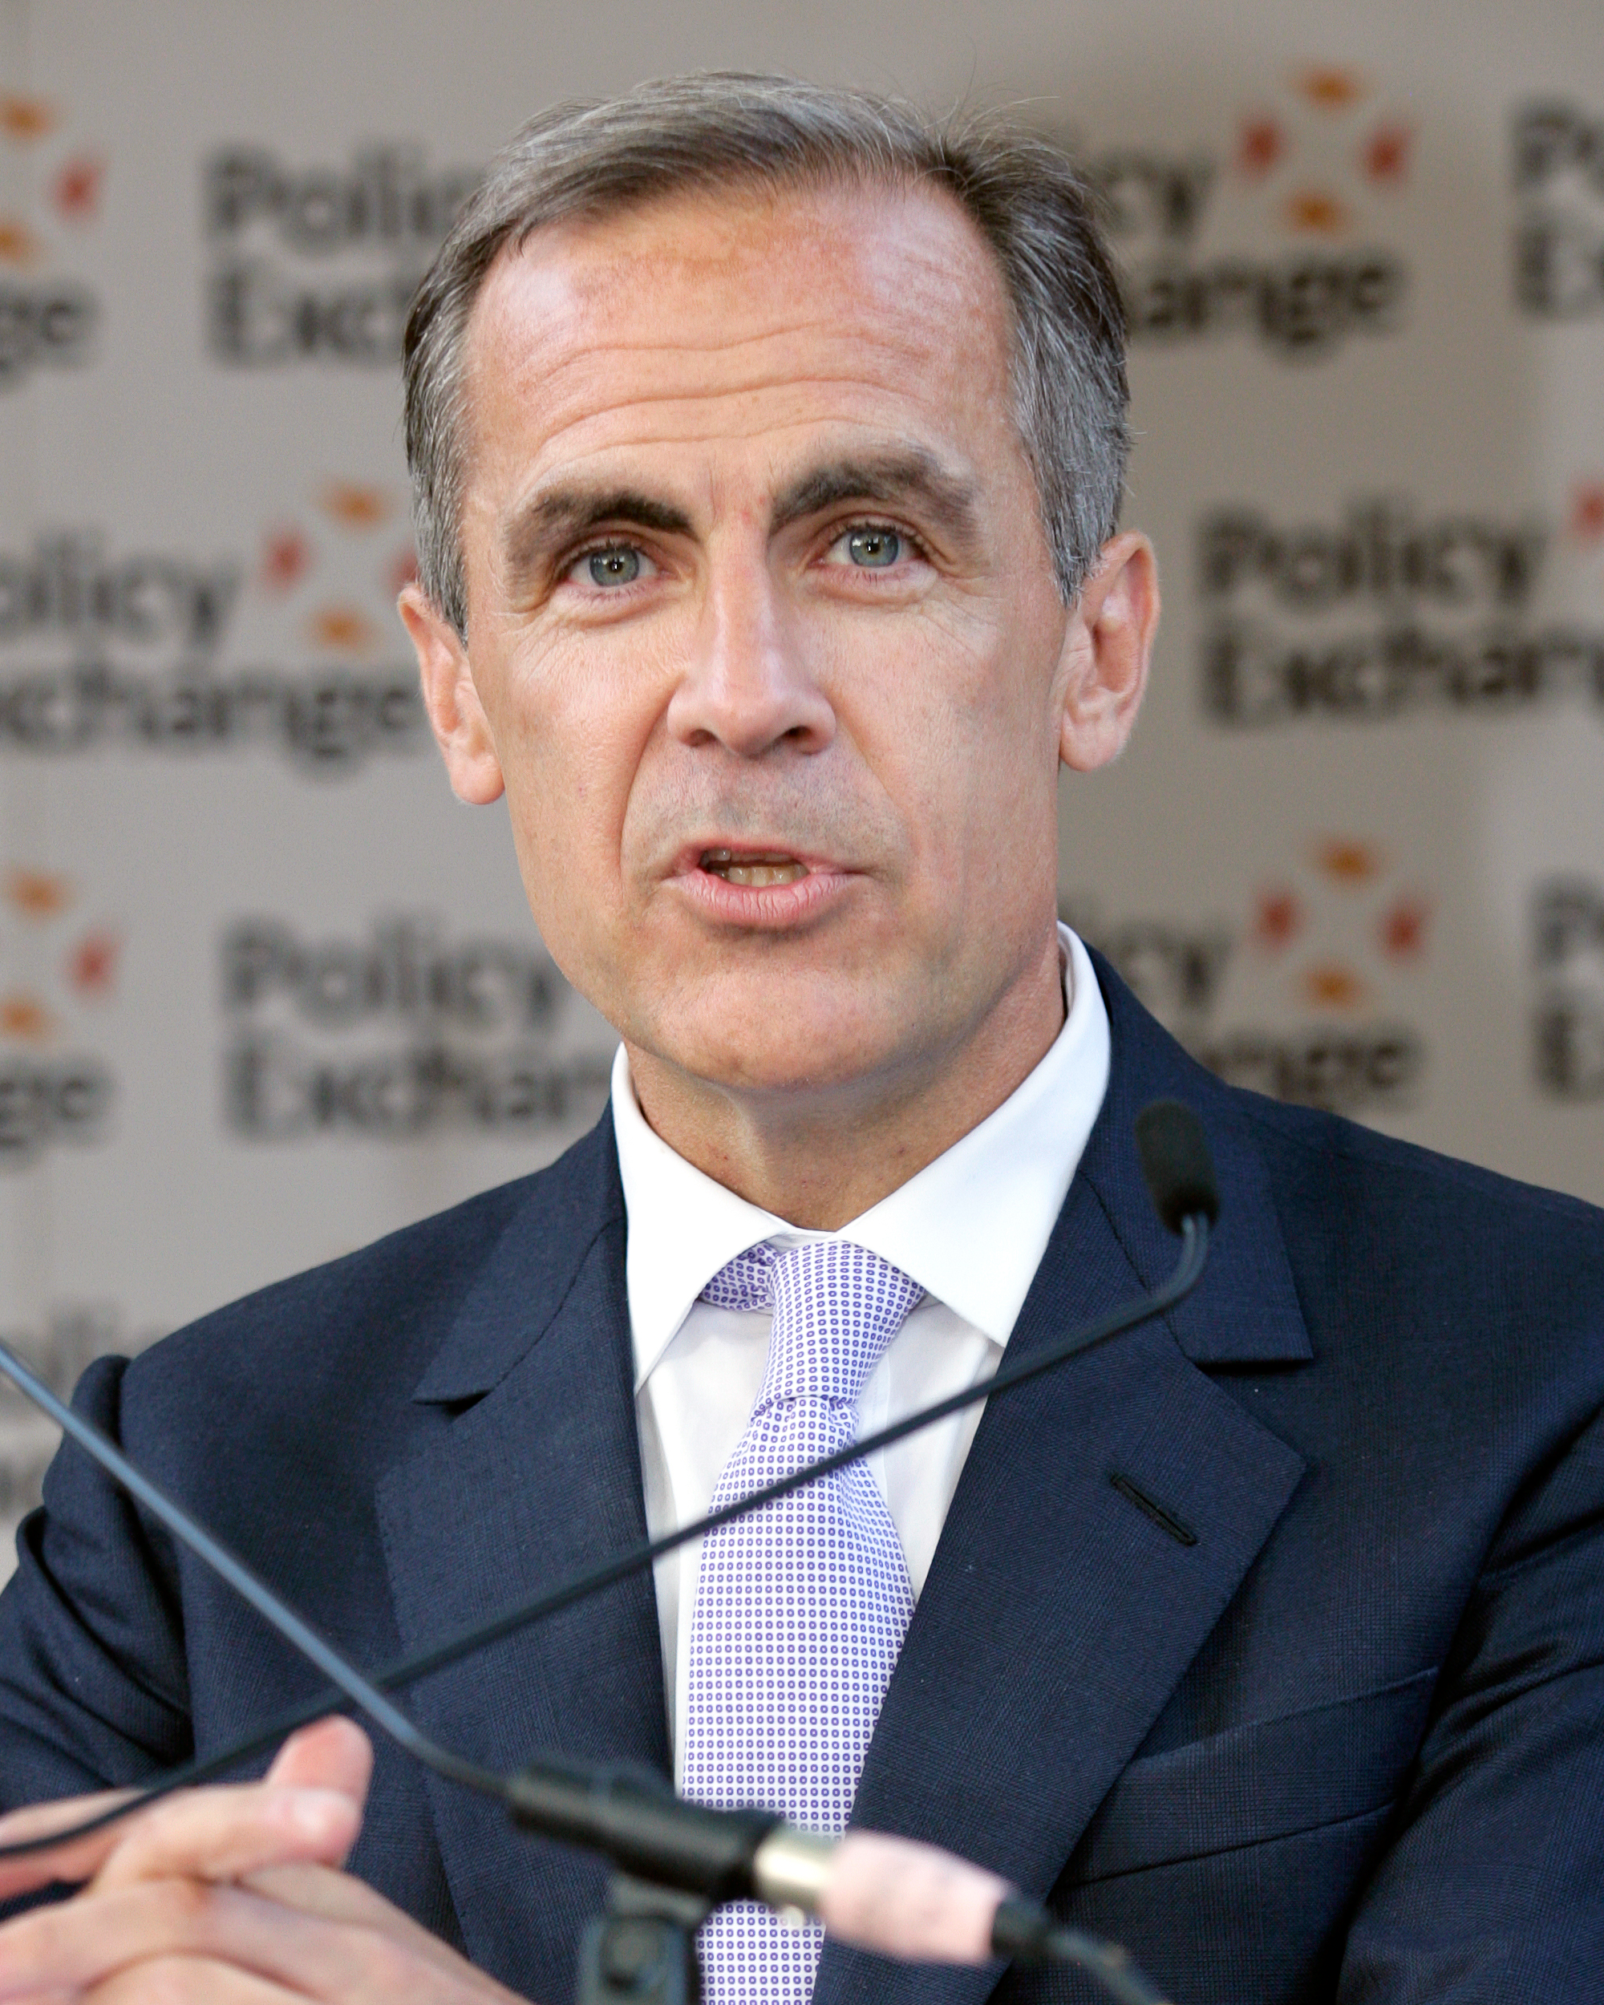
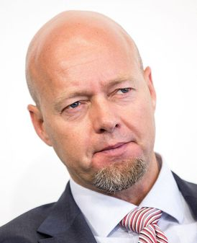
Current Disclosure practices
Regulators and investors argue that current climate risk disclosure is insufficient
  Mark Carney, ex-Governor of the Bank of England, called for more to be done “to develop consistent, comparable, reliable and clear disclosure around the carbon intensity of different assets.” and companies needed to “increase the quantity and quality of their [climate-related] disclosures.”
  Ex-CEO of NBIM, Yngve Slyngstad stated that “the only surprise […] is how hard it is to get the data […] I think it will take years to get good data from the majority of companies we are invested in.”
To address shortcomings in current disclosures, regulators, investors, and seek to improve reporting on climate risks
Notes:
Emphasize how important it is to have an objective function that is observable and measurable. Note that stock prices provide almost instantaneous feedback (some of which is unwelcome) on every decision you make as a firm.
Consider the example of an acquisition announcement and the market reaction to it. Stock prices of the acquiring firm tend to drop in a significant proportion of acquisitions. Why might markets be more pessimistic than managers about the expected success of an acquisition? Because the track record of firms on acquisitions is not very good.

Slide 6
What we do
Systematic evidence from survey and archival data on the preferences of institutional investors with respect to climate-related disclosures
Illustrate that
  They value and demand climate-related disclosures
  Their disclosure demand is affected by climate-specific disclosure costs and benefits
  Influence and selection effects explain the relations between institutional ownership and disclosure
Data
  Build on climate-related disclosure data from the CDP
  Preview the analyses of these archival data with insights from a survey
Notes:
Emphasize how important it is to have an objective function that is observable and measurable. Note that stock prices provide almost instantaneous feedback (some of which is unwelcome) on every decision you make as a firm.
Consider the example of an acquisition announcement and the market reaction to it. Stock prices of the acquiring firm tend to drop in a significant proportion of acquisitions. Why might markets be more pessimistic than managers about the expected success of an acquisition? Because the track record of firms on acquisitions is not very good.

Slide 7
measuring institutional ownership
Stewardship code IO
  Ownership from countries where investors are expected to follow stewardship codes that aim at promoting corporate sustainability
  Institutions subject to them should have a higher propensity to demand climate-related disclosure from portfolio firms
High-norm IO
  Demand for climate reporting should be based on whether institutions are from countries where norms make them more climate-conscious
Universal owner IO
  Climate-related disclosure can pressure firms to reduce carbon emissions
  Externality benefits likely matter the most for universal owners due to their broad ownership across many firms
Label these three types of institutional investors as “climate-conscious”
Notes:
Emphasize how important it is to have an objective function that is observable and measurable. Note that stock prices provide almost instantaneous feedback (some of which is unwelcome) on every decision you make as a firm.
Consider the example of an acquisition announcement and the market reaction to it. Stock prices of the acquiring firm tend to drop in a significant proportion of acquisitions. Why might markets be more pessimistic than managers about the expected success of an acquisition? Because the track record of firms on acquisitions is not very good.

Slide 8
Measuring Climate-related disclosures
Scope 1 disclosure
  Disclose of Scope 1 carbon emissions to the CDP
  Scope 1 emissions are directly owned and controlled by firms
Climate risk disclosure
  Disclosure on broadly-defined climate risks: regulatory, physical, and other risks
Climate disclosure score
  Score that measures the completeness of a firm’s survey responses to capture the overall quality of the CDP disclosures
Complementary tests
  Scope 1 verification
  Scope 1 country breakdown
  (Not in this talk: 10K disclosures)
Notes:
Emphasize how important it is to have an objective function that is observable and measurable. Note that stock prices provide almost instantaneous feedback (some of which is unwelcome) on every decision you make as a firm.
Consider the example of an acquisition announcement and the market reaction to it. Stock prices of the acquiring firm tend to drop in a significant proportion of acquisitions. Why might markets be more pessimistic than managers about the expected success of an acquisition? Because the track record of firms on acquisitions is not very good.

Slide 9
Hypotheses
Baseline relations
  Climate-conscious institutional ownership is positively related to climate risk disclosure
Costs and benefits of climate-related disclosure
  Effect weakened if the proprietary costs of the disclosure are higher
    Consider role of competition
  Effect strengthened if the information production costs of the disclosure are relatively lower
    Consider role of firm size
  Effect strengthened if the externality benefits from the disclosure are higher
    Consider role of carbon emissions
Notes:
Emphasize how important it is to have an objective function that is observable and measurable. Note that stock prices provide almost instantaneous feedback (some of which is unwelcome) on every decision you make as a firm.
Consider the example of an acquisition announcement and the market reaction to it. Stock prices of the acquiring firm tend to drop in a significant proportion of acquisitions. Why might markets be more pessimistic than managers about the expected success of an acquisition? Because the track record of firms on acquisitions is not very good.

Slide 10
Getting at Identification
Beyond showing correlations, perform three tests that exploit specific settings
Shocks to demand of climate-related information
  Climate risk disclosure of firm owned by many French institutional investors increases in response to the French Article 173 in 2016
  Climate risk disclosure of firms targeted by Climate Action 100+ from 2018 improves after being engaged by the investor coalition
Shocks to supply of climate-related information
  Climate-conscious institutional ownership in prior UK nondisclosers increases in response to the UK mandatory carbon disclosure requirement from 2013
Notes:
Emphasize how important it is to have an objective function that is observable and measurable. Note that stock prices provide almost instantaneous feedback (some of which is unwelcome) on every decision you make as a firm.
Consider the example of an acquisition announcement and the market reaction to it. Stock prices of the acquiring firm tend to drop in a significant proportion of acquisitions. Why might markets be more pessimistic than managers about the expected success of an acquisition? Because the track record of firms on acquisitions is not very good.

Slide 11
Survey sample
Preview the analyses of archival data with insights from a survey
Purpose of validating key hypotheses tested in the data, and of adding insights difficult to research through archival methods
Respondent group consists of important decision makers at some of the world’s largest investors:
  Global respondent group
  1/3 of the 439 respondents at the executive level in their institutions
  11% work for institutions with $100+bn in assets under management
Notes:
Emphasize how important it is to have an objective function that is observable and measurable. Note that stock prices provide almost instantaneous feedback (some of which is unwelcome) on every decision you make as a firm.
Consider the example of an acquisition announcement and the market reaction to it. Stock prices of the acquiring firm tend to drop in a significant proportion of acquisitions. Why might markets be more pessimistic than managers about the expected success of an acquisition? Because the track record of firms on acquisitions is not very good.

Slide 12
Survey Results
Importance of climate reporting compared to financial reporting
Notes:
Emphasize how important it is to have an objective function that is observable and measurable. Note that stock prices provide almost instantaneous feedback (some of which is unwelcome) on every decision you make as a firm.
Consider the example of an acquisition announcement and the market reaction to it. Stock prices of the acquiring firm tend to drop in a significant proportion of acquisitions. Why might markets be more pessimistic than managers about the expected success of an acquisition? Because the track record of firms on acquisitions is not very good.

Slide 13
Survey Results
Views on Current Climate Risk Disclosure Practices (Percentages)
 | Strongly disagree | Disagree | Neither agree nor disagree | Agree | Strongly agree
Management discussions on climate risk are not sufficiently precise | 1 | 9 | 22 | 47 | 21
Firm-level quantitative information on climate risk is not sufficiently precise | 1 | 7 | 24 | 48 | 19
Standardized and mandatory reporting on climate risk is necessary | 2 | 5 | 20 | 46 | 27
There should be more standardization across markets in climate-related financial disclosure | 2 | 7 | 16 | 48 | 27
Standardized disclosure tools and guidelines are currently not available | 3 | 12 | 24 | 40 | 21
Mandatory disclosure forms are not sufficiently informative regarding climate risk | 3 | 6 | 28 | 46 | 18
Investors should demand that portfolio firms disclose their exposure to climate risk | 2 | 6 | 18 | 46 | 28
Notes:
Emphasize how important it is to have an objective function that is observable and measurable. Note that stock prices provide almost instantaneous feedback (some of which is unwelcome) on every decision you make as a firm.
Consider the example of an acquisition announcement and the market reaction to it. Stock prices of the acquiring firm tend to drop in a significant proportion of acquisitions. Why might markets be more pessimistic than managers about the expected success of an acquisition? Because the track record of firms on acquisitions is not very good.

Slide 14
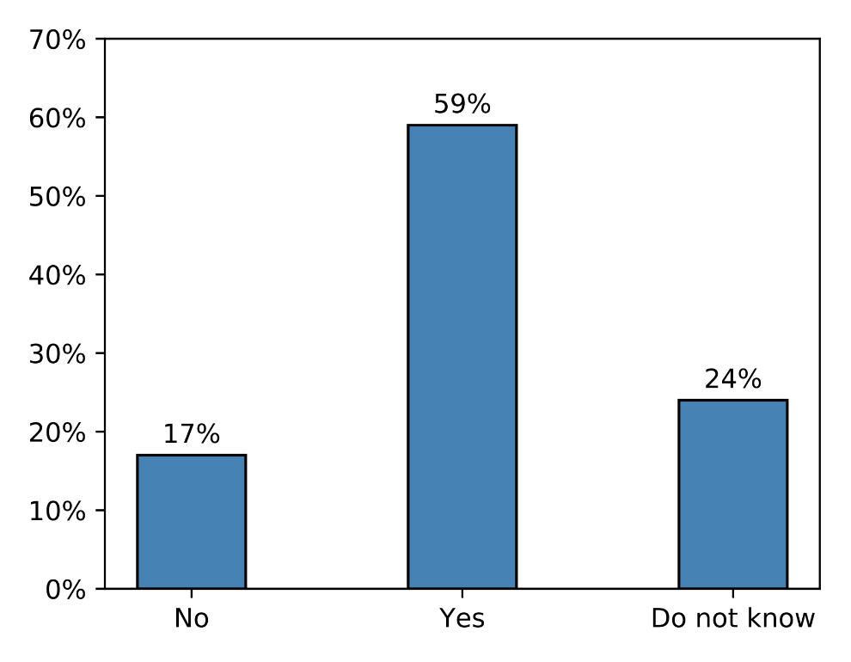
Survey Results
Do you engage (or plan to engage) portfolio companies to report according to the recommendations of the TCFD?
Notes:
Emphasize how important it is to have an objective function that is observable and measurable. Note that stock prices provide almost instantaneous feedback (some of which is unwelcome) on every decision you make as a firm.
Consider the example of an acquisition announcement and the market reaction to it. Stock prices of the acquiring firm tend to drop in a significant proportion of acquisitions. Why might markets be more pessimistic than managers about the expected success of an acquisition? Because the track record of firms on acquisitions is not very good.

Slide 15
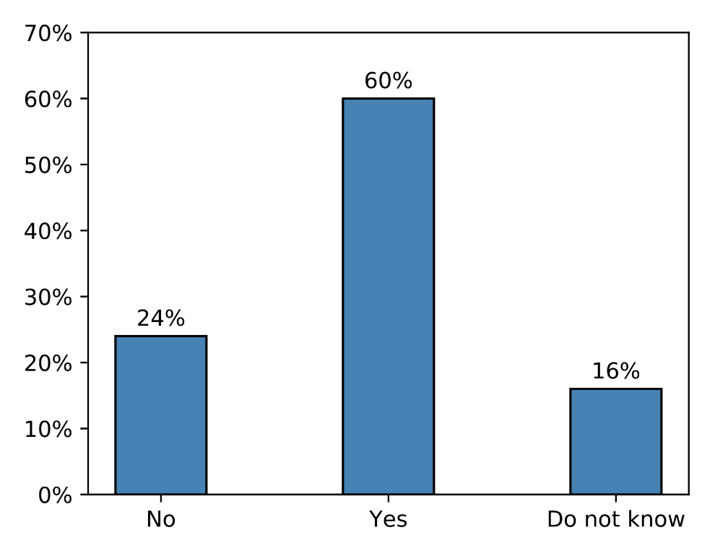
Survey Results
Do you disclose (or plan to disclose) the overall carbon footprint of your portfolio?
Notes:
Emphasize how important it is to have an objective function that is observable and measurable. Note that stock prices provide almost instantaneous feedback (some of which is unwelcome) on every decision you make as a firm.
Consider the example of an acquisition announcement and the market reaction to it. Stock prices of the acquiring firm tend to drop in a significant proportion of acquisitions. Why might markets be more pessimistic than managers about the expected success of an acquisition? Because the track record of firms on acquisitions is not very good.

Slide 16
ARCHIVAL sample
Disclosure data collected by the CDP
  Annual survey of firms on behalf of institutional investors
CDP does not reveal which firms they contact for participation in the survey
  Difficult to identify whether a missing observation is due to a firm’s refusal to participate, or because a firm was not requested to participate
To remedy this issue, follow the approach in Krueger (2015)
  CDP typically requests information from the largest publicly listed firms in a country
  Sample of firms that the CDP likely contacted based on their size relative to other firms in their countries
Notes:
Emphasize how important it is to have an objective function that is observable and measurable. Note that stock prices provide almost instantaneous feedback (some of which is unwelcome) on every decision you make as a firm.
Consider the example of an acquisition announcement and the market reaction to it. Stock prices of the acquiring firm tend to drop in a significant proportion of acquisitions. Why might markets be more pessimistic than managers about the expected success of an acquisition? Because the track record of firms on acquisitions is not very good.

Slide 17
Baseline estimation
Not all measures available for all years
Includes measure of overall financial disclosure quality by Chen, Miao, and Shevlin (2015)
A standard deviation increase Stewardship Code IO implies an increase in the Scope 1 disclosure rate by 3pp, or 12% of the variable’s unconditional probability
Notes:
Emphasize how important it is to have an objective function that is observable and measurable. Note that stock prices provide almost instantaneous feedback (some of which is unwelcome) on every decision you make as a firm.
Consider the example of an acquisition announcement and the market reaction to it. Stock prices of the acquiring firm tend to drop in a significant proportion of acquisitions. Why might markets be more pessimistic than managers about the expected success of an acquisition? Because the track record of firms on acquisitions is not very good.

Slide 18
Costs and benefits of climate-related disclosure
Demand for climate risk reporting depends on the costs and benefits of the disclosures
  Goldstein and Yang (2017); Christensen, Hail, and Leuz (2019)
Strong evidence that disclosure demand is affected by climate-specific disclosure costs and benefits
Effect of climate-conscious ownership on climate-related disclosure is
  Moderated among firms with high proprietary disclosure costs
  Magnified among large firms with lower information production costs
  Magnified among firms in highly carbon-polluting industries

Slide 19



Influence versus selection effects
Estimated relations may exist for two nonmutually exclusive reasons.
Influence Effect
  Climate-conscious institutions may actively engage firms to demand that they voluntarily produce such information
Selection Effect
  Climate-conscious institutions could have a propensity to invest in firms that provide such disclosures
Explore three settings to understand where the relations originate from

Slide 20
French Article 173 in 2016
Scope 1 disclosure increases by 4pp more at firms with high French ownership after Article 173 (compares with mean of 26%)
Other variables not available for the tests

Slide 21
Climate Action 100+ in 2018
Scope 2 and 3 verification increases by 17pp and 31pp, compares to verification propensities of 78% and 54% among targets before 2018
Other variables not available for the tests

Slide 22
UK Mandatory Carbon Disclosure in 2013
Stewardship-code IO increases by 1.8pp more at UK firms forced to comply, which compares with an average stewardship-code ownership in UK pre-reform noncompliers of 21% (coefficients x10)

Slide 23
Conclusions
Institutional investors value and demand climate-related disclosures
Their disclosure demand is affected by climate-specific disclosure costs and benefits
Influence and selection effects explain the equilibrium relations between institutional ownership and disclosure
More broadly:
Evidence on how “capitalism can help fight climate change” (FAZ 2021)
Why hope?
More disclosure has been shown to lead to reduced emissions
What actions?
Structured, data-driven mandatory reporting
Notes:
Emphasize how important it is to have an objective function that is observable and measurable. Note that stock prices provide almost instantaneous feedback (some of which is unwelcome) on every decision you make as a firm.
Consider the example of an acquisition announcement and the market reaction to it. Stock prices of the acquiring firm tend to drop in a significant proportion of acquisitions. Why might markets be more pessimistic than managers about the expected success of an acquisition? Because the track record of firms on acquisitions is not very good.

Slide 24
Thank YOU for your attention

Slide 25
Survey conclusions
Strong belief that climate-related disclosure is important
Current climate risk disclosures perceived as uninformative and imprecise
Strong investor demand for climate-related disclosures
Institutions actively engage firms to improve such disclosures
In paper: Investors from countries with high environmental norms and large (universal) investors
  Attach greater importance to climate risk reporting
  Exhibit a higher willingness to engage firms to demand such disclosures
In paper: Respondents who believe that current reporting is lacking see more climate-related overvaluation
Notes:
Emphasize how important it is to have an objective function that is observable and measurable. Note that stock prices provide almost instantaneous feedback (some of which is unwelcome) on every decision you make as a firm.
Consider the example of an acquisition announcement and the market reaction to it. Stock prices of the acquiring firm tend to drop in a significant proportion of acquisitions. Why might markets be more pessimistic than managers about the expected success of an acquisition? Because the track record of firms on acquisitions is not very good.

Slide 26
A side: 10-K Climate risk disclosure
Institutional ownership variables unrelated to a count-based measure of climate-related key words
  Matsumura, Prakash, and Vera-Mundoz (2020)
Find significant effects only for universal ownership for an ML measure
  Kölbel et al. (2020)
Weaker results could be caused by the generally less-structured and less-standardized climate disclosures in 10-Ks
  More easily greenwashed compared to CDP disclosures
  Survey corroborates this interpretation: respondents emphasize lack of standardization and uninformative data as problems of mandatory disclosures such as in 10-Ks

Slide 27
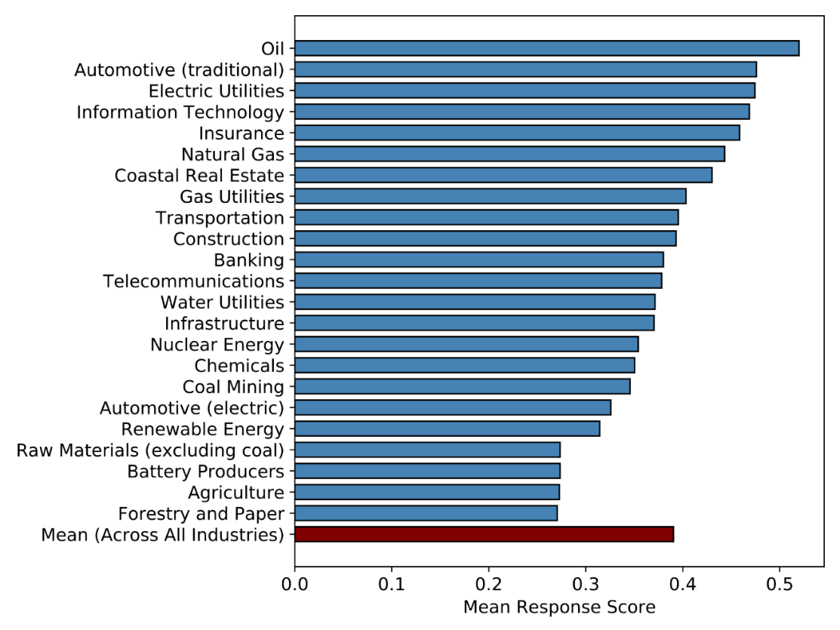
Survey Misvaluations
Notes:
Emphasize how important it is to have an objective function that is observable and measurable. Note that stock prices provide almost instantaneous feedback (some of which is unwelcome) on every decision you make as a firm.
Consider the example of an acquisition announcement and the market reaction to it. Stock prices of the acquiring firm tend to drop in a significant proportion of acquisitions. Why might markets be more pessimistic than managers about the expected success of an acquisition? Because the track record of firms on acquisitions is not very good.

Slide 28
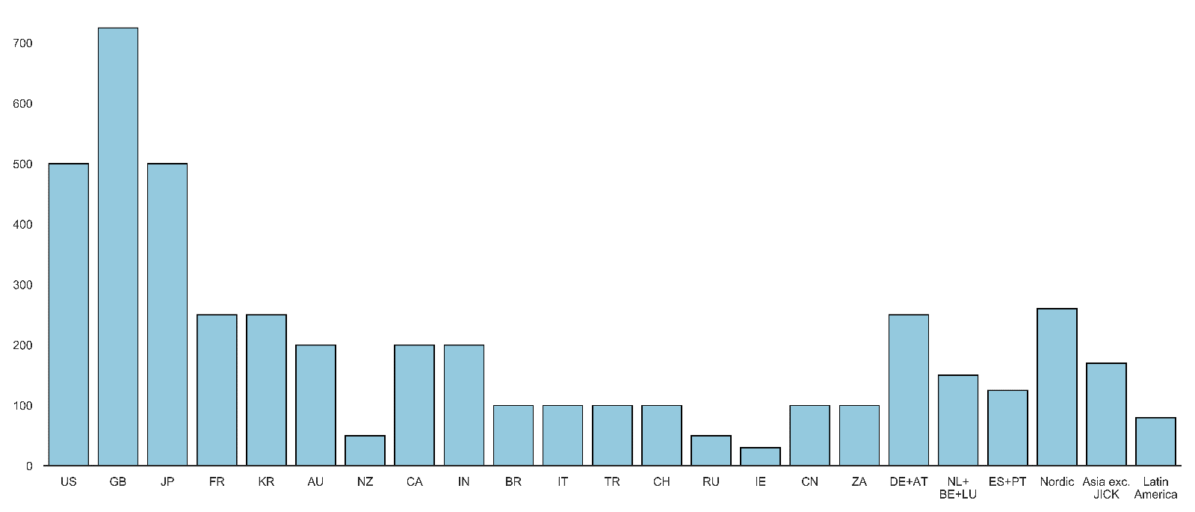
Archival sample

